Slide 1
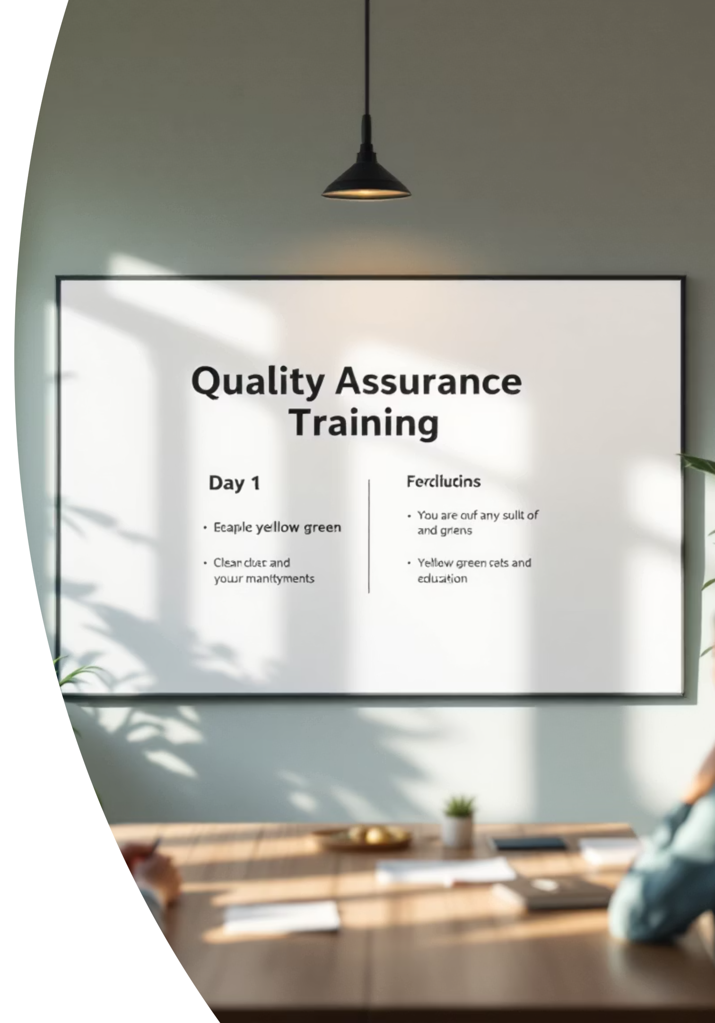
Quality Assurance (QA) Training – Day 1
BIT – 5th Semester (Professional Class)
Facilitator: Neha Rouniyar

Slide 2

Laying the Foundation
Introduction to Quality Assurance, SDLC, & STLC

Slide 3




FUNDAMENTALS
What is Quality Assurance (QA)?
Ensuring Product Excellence
Focused on the Process
QA is the step-by-step process of making sure a product or service meets what's needed and customer expectations.
It focuses on the entire development process, not just the end product, to build quality in from the beginning.
Catching Problems Early
QA aims to find and stop problems early in the software development lifecycle, saving time and resources later on.

Slide 4
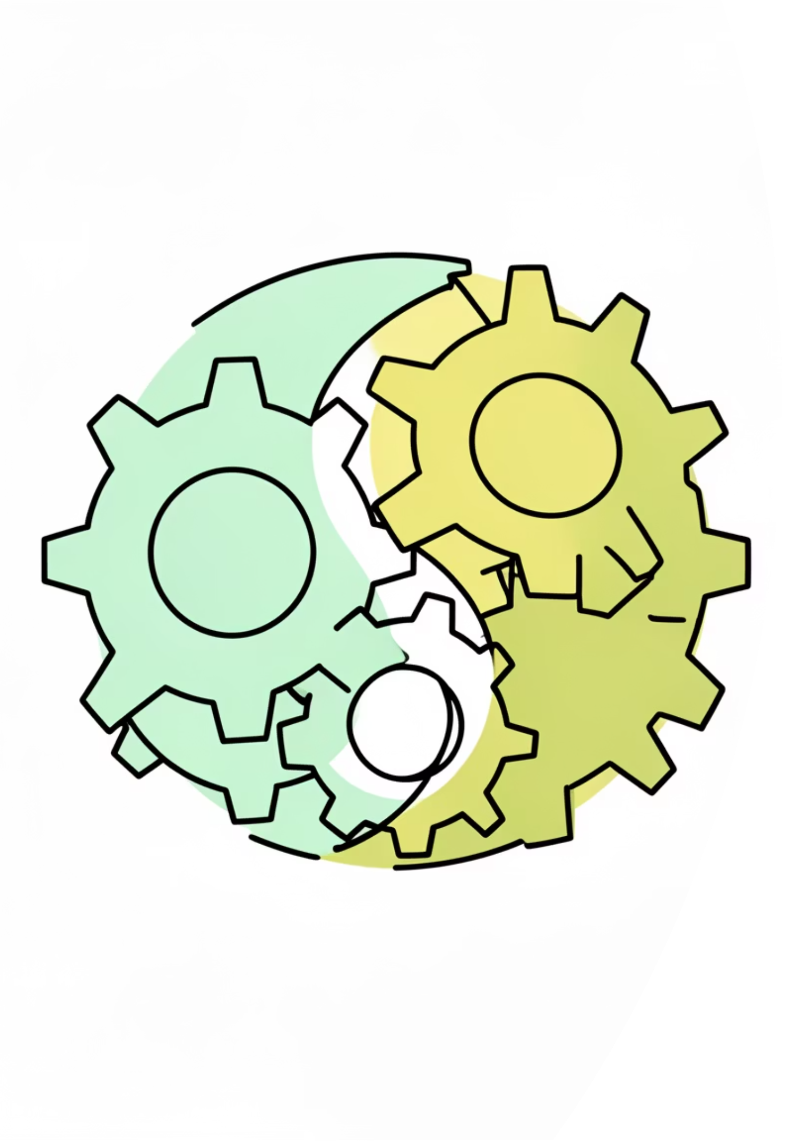


DISTINCTIONS
QA vs. Quality Control (QC)
Quality Assurance (QA)
A focused on the process activity focused on stopping problems. It sets standards and ensures they are followed throughout development.
Quality Control (QC)
A focused on the product activity focused on finding problems. It involves testing the final product to find defects.
Both QA and QC are critical and work hand-in-hand to deliver a high-quality product.

Slide 5





IMPACT
The Essential Role of QA
Fewer Problems
Saves Money & Time
Catching problems early in QA means fewer bugs in the final product, making software more stable and dependable.
Catching issues early greatly lowers how much money and time is spent fixing things after release.
Better User Experience
Easier Launches
A good product is easy to use, dependable, and works well, making users happier and more loyal.
Thorough QA makes sure new features and products can be launched with confidence and very little trouble.

Slide 6


ROLES
Key Tasks of a QA Professional
Understand What's Needed: Really get to know what the project needs and what users want.
Make Test Steps: Plan out clear steps to check how things work and how well they perform.
Run Tests: Follow a step-by-step process to run tests and find problems.
Record Bugs: Write down problems clearly, including how to find them again and what should happen.
Re-test Fixes: Check that the problems reported have really been fixed.
Help with Releases: Support the launch process to make sure the product goes live smoothly.

Slide 7
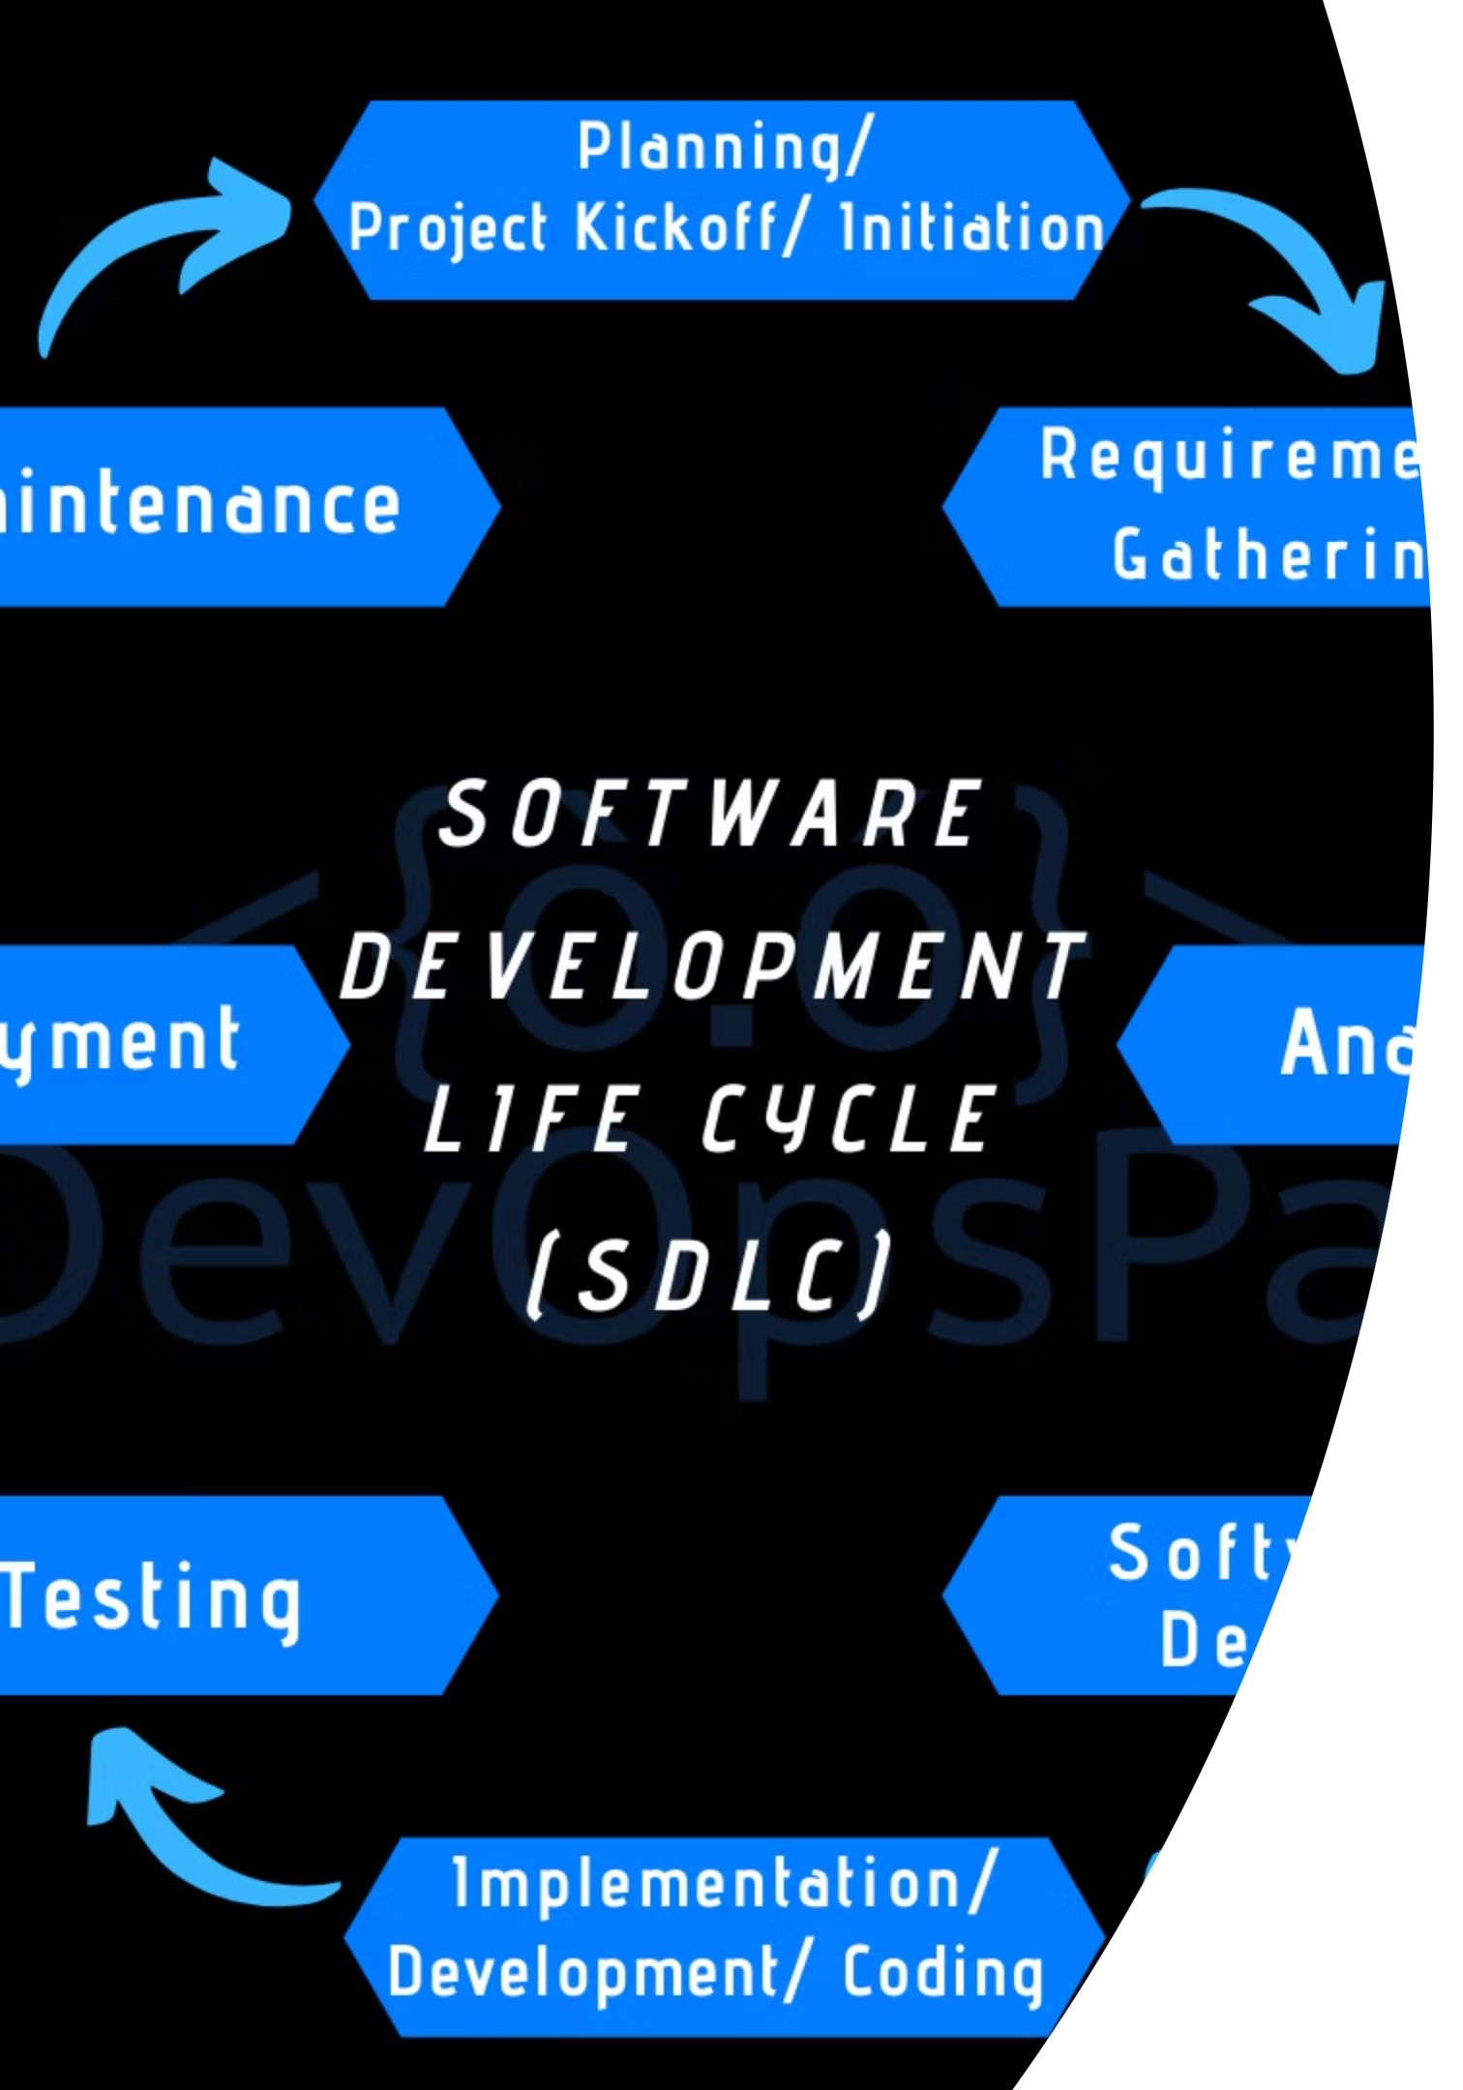
DEVELOPMENT
Understanding the Software Development Lifecycle (SDLC)
The SDLC is a step-by-step process that outlines the stages involved in developing a software product.
Requirements
Gathering and looking at what users need and what the project should cover.
Design
Planning how the software will be built and how people will use it.
Development
Writing the code for the software based on the plan.
Testing
Checking that the software does what's needed and has no problems.
Deployment
Giving the software to users or customers.
Maintenance
Fixing, updating, and improving the software after it's released.

Slide 8
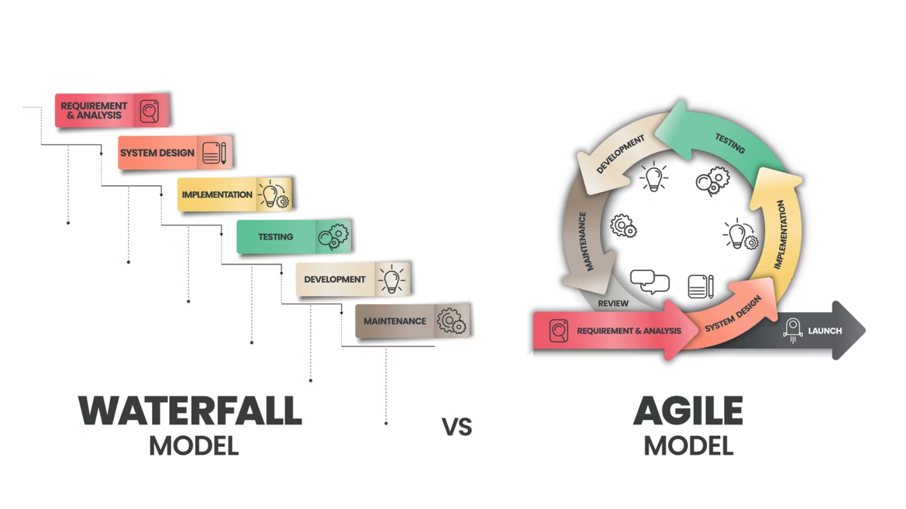
METHODOLOGIES
Key SDLC Models: Waterfall vs. Agile
Waterfall Model
Agile Model
A linear, steps in order approach where each phase must be completed before the next begins.
A step-by-step and repeated approach, focusing on flexibility, collaboration, and rapid delivery.
Simple and easy to manage.
Highly adaptable to changing requirements.
Lack of flexibility for changes once a phase is complete.
Widely adopted in modern software development for its speed and efficiency.

Slide 9

TESTING
The Software Testing Lifecycle (STLC)
STLC defines the steps in order for effective software testing, ensuring thorough testing.
Requirement Analysis
Test Case Design
Test Execution
Test Cycle Closure
Creating detailed test cases, scenarios, and scripts.
Running test cases and comparing actual results with expected results.
Concluding the testing process, analyzing results, and reporting on overall quality.
Understanding the 'what' of testing, derived from product requirements.
1
2
3
4
5
6
7
Test Planning
Test Environment Setup
Bug Reporting & Tracking
Defining scope, strategy, resources, and timelines for testing activities.
Preparing the necessary hardware and software for testing.
Documenting defects and monitoring their resolution status.

Slide 10

PRACTICAL STEPS
The QA Workflow in Action
Understand
Understand what's needed well.
Plan
Plan how to test.
Design Tests
Create good ways to test.
Execute
Run tests, find problems.
Report Bugs
Write down and track problems.
Re-test
Check if problems are fixed.
Close
Finish testing, make sure it's good.

Slide 11


Day 1: Activity & Summary
Activity
Pick any application you use daily (e.g., WhatsApp, ATM, or an e-commerce app).
Your Task: List 5 different things you would test on this application to ensure its quality.
Key Takeaways from Today
QA Fundamentals
QA vs. QC
SDLC Overview
Agile vs. Waterfall
STLC Phases
QA Workflow

Slide 12

Questions & Discussion

